Slide 1
Pattern Designation
In C programming

Slide 2
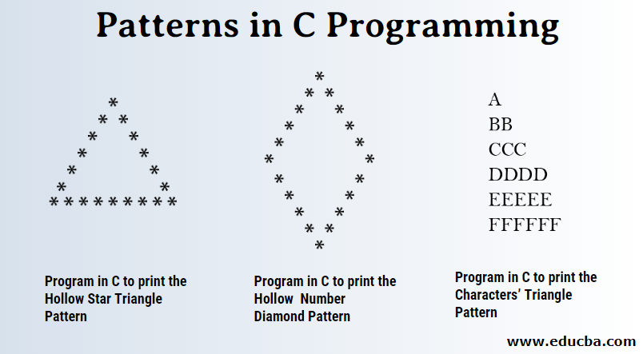
What is pattern and pattern designation?
If Some letters or the character arranged with some special order or with sequential order that is pattern.
Process of designing those pattern is called pattern designation.

Slide 3
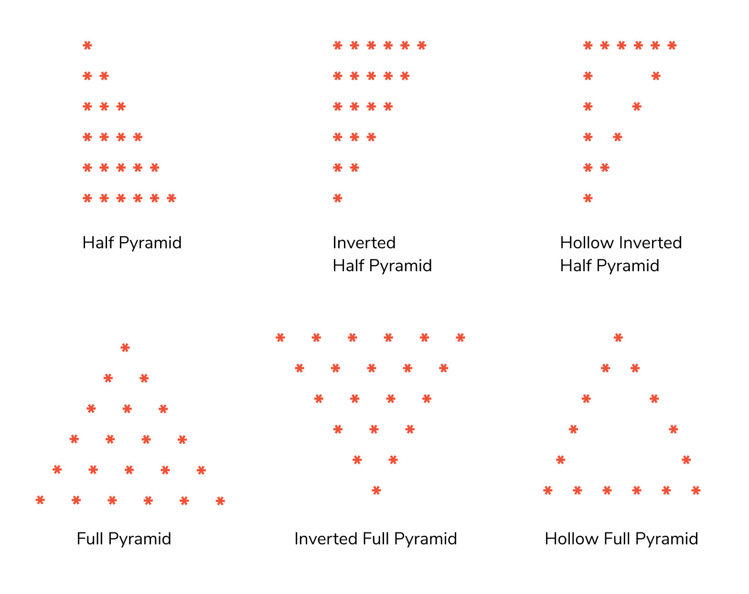
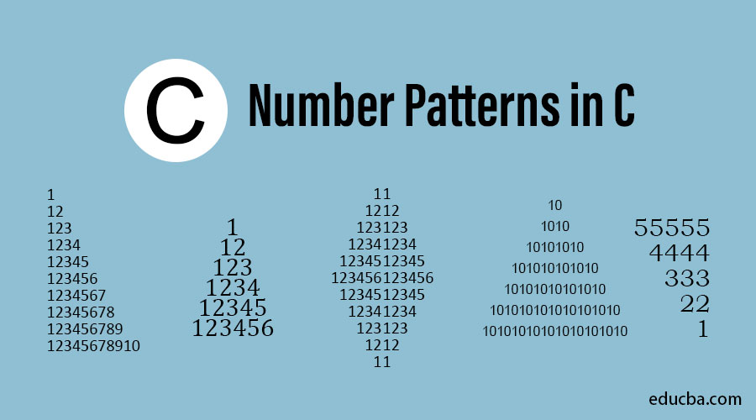
Some Patterns in C programming

Slide 4
Overview to print patterns in c!
Algorithm to print this pattern:
Step1: print one star using printf() function.
Step2: Print all the five star of the first row using for loop.
Step3: Put first row’s loop in the another outer loop to print the same row five times.
Example 1: Square(5 rows and 5 columns):
* * * * *
* * * * *
* * * * *
* * * * *

Slide 5
Printing Right angle triangle.
Algorithm to print this pattern:
Step1: Start
Step2: Initialize variables(i for row and j for column).
Step3: Use for loop to print the first row.
Step 4:Put that for loop in another for loop to print this row 5 times.
Step 5: Inside this nested loop use conditional statement.
In conditional statement we use the condition by following previously mentioned steps.
Example 2: Right angle triangle(5 rows and 5 columns):
*
* *
* * *
* * * *
* * * * *

Slide 6
Steps to print these pattern:
Step A: Put the star pattern in the table to analyze its pattern.
Step B:Find the expression/condition for this pattern.
Step C:Put that expression’s logic in the conditional statement to get the exact pattern in the consol.

Slide 7
* * * * * * * * * * * * * * *
Step2: Analyzing table.
Step1: Putting pattern in table.
No. of stars in i=row and j=column
Row=i | Column=j | range | relation
1 | 1 | j<=1 | j<=i
2 | 1,2 | j<=2 | j<=i
3 | 1,2,3 | j<=3 | j<=i
4 | 1,2,3,4 | j<=4 | j<=i
5 | 1,2,3,4,5 | j<=5 | j<=i
S.N | Column(j=1) | j=2 | j=3 | j=4 | j=5
row(i)=1 | *
i=2 | * | *
i=3 | * | * | *
i=4 | * | * | * | *
i=5 | * | * | * | * | *

Slide 8
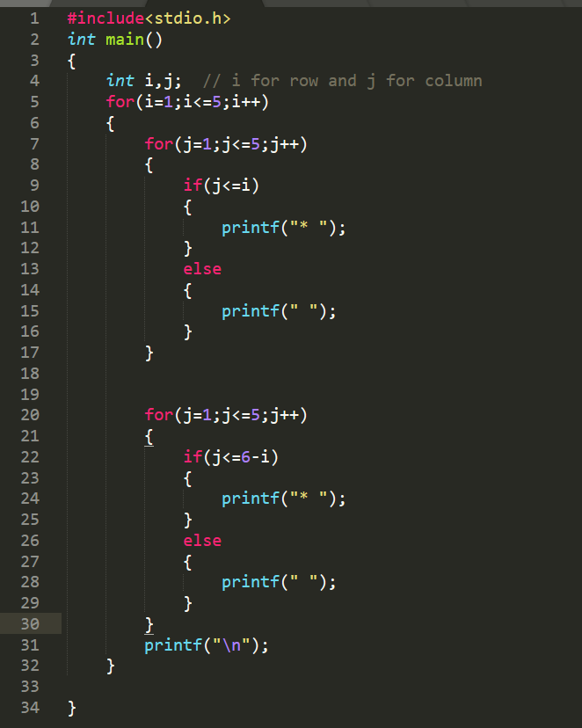
Step 3: Now the found condition(j<=i) we will put this statement in the conditional statements.
Key point: In place where there is no star(*) there is special character(i.e, space).

Slide 9
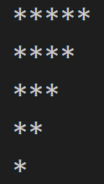
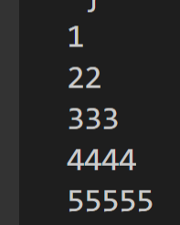
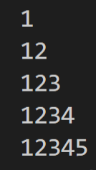
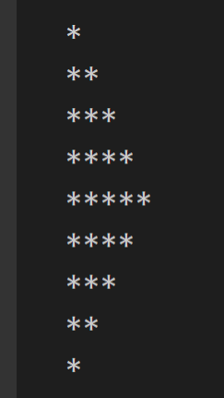
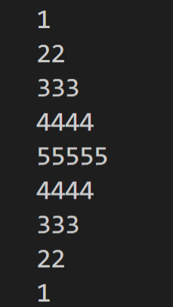
Following patterns can also be printed doing some modification in the code:

Slide 10
Right angle triangle aligned in right side.
Algorithm to print this pattern:
Step1: Start
Step2: Initialize variables(i for row and j for column).
Step3: Use for loop to print the first row.
Step 4:Put that for loop in another for loop to print this row 5 times.
Step 5: Inside this nested loop us conditional statement.
In conditional statement we use the condition by following previously mentioned steps.
Example3:
 |  |  |  | *
 |  |  | * | *
 |  | * | * | *
 | * | * | * | *
* | * | * | * | *

Slide 11
.
 |  |  |  | *
 |  |  | * | *
 |  | * | * | *
 | * | * | * | *
* | * | * | * | *
Step A: Step B:
S.N | j=1 | j=2 | j=3 | j=4 | j=5
i=1 |  |  |  |  | *
i=2 |  |  |  | * | *
i=3 |  |  | * | * | *
i=4 |  | * | * | * | *
i=5 | * | * | * | * | *
Number of star in row(i) and column(j)
i=row | j=column | Range of j | condition
1 | ,5 | j>=5 | j>=6-i
2 | 4,5 | j>=4 | j>=6-i
3 | 3,4,5 | j>=3 | j>=6-i
4 | 2,3,4,5 | j>=2 | j>=6-i
5 | 1,2,3,4,5 | j>=1 | j>=6-i

Slide 12
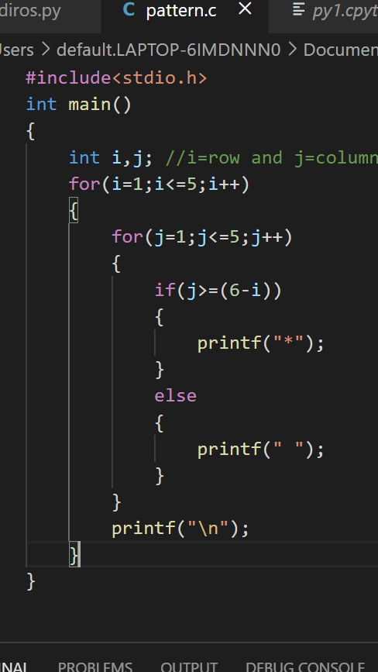
Step C: Now the found condition(j>=6-i) we will put this statement in the conditional statements.
Key point: In place where there is no star(*) there is special character(i.e, space).

Slide 13
Example2: Pyramid pattern in c.
Algorithm to print this pattern:
Step1: Start
Step2: Initialize variables(i for row and j for column).
Step3: Use for loop to print the first row.
Step 4:Put that for loop in another for loop to print this row 5 times.
Step 5: Inside this nested loop us conditional statement.
In conditional statement we use the condition by following previously mentioned steps.
 |  |  |  | *
 |  |  | * | * | *
 |  | * | * | * | * | *
 | * | * | * | * | * | * | *
* | * | * | * | * | * | * | * | *

Slide 14
,
 |  |  |  | *
 |  |  | * | * | *
 |  | * | * | * | * | *
 | * | * | * | * | * | * | *
* | * | * | * | * | * | * | * | *
Step A: Step B:
S.N | j=1 | j=2 | j=3 | j=4 | j=5 | j=6 | j=7 | j=8 | j=9
i=1 |  |  |  |  | *
i=2 |  |  |  | * | * | *
i=3 |  |  | * | * | * | * | *
i=4 |  | * | * | * | * | * | * | *
i=5 | * | * | * | * | * | * | * | * | *
row=i | column=j | range | Condition
1 | ,5 | J>=5&&j<=5 // j>=6-1&&j<=4+1 | j>=6-i&&j<=4+i
2 | 4,5,6 | j>=4&&j<=6 // j>=6-2&&j<=4+2 | j>=6-i&&j<=4+i
3 | 3,4,5,6,7 | j>=3&&j<=7 // j>=6-3&&j<=4+3 | j>=6-i&&j<=4+i
4 | 2,3,4,5,6,7,8 | J>=2&&j<=8 // j>=6-4&&j<=4+4 | j>=6-i&&j<=4+i
5 | 1,2,3,4,5,6,7,8,9 | j>=1&&j<=9 // j>=6-5&&j<=4+5 | j>=6-i&&j<=4+i

Slide 15
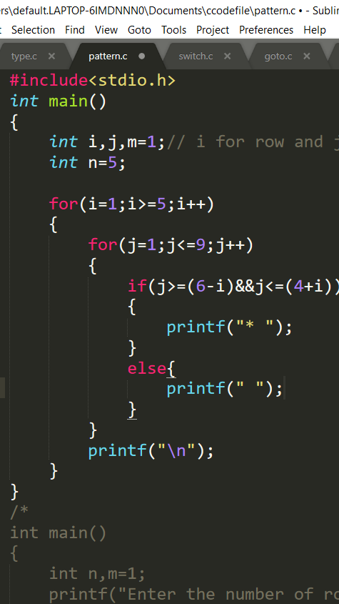
Step C: Now the found condition(>=6-i&&j<=4+i) we will put this statement in the conditional statements.
Key point: In place where there is no star(*) there is special character(i.e, space).

Slide 16

If you have any questions???

